Slide 1


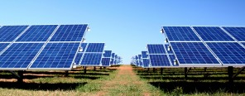
Modeling the Performance of Solar Photovoltaic Systems
DEEDS
M. Tahir Patel, Xingshu Sun, Reza Asadpour and M. Ashraf Alam
School of Electrical and Computer Engineering
Purdue University, West Lafayette, IN, 47907, USA
06/29/2018

Slide 2
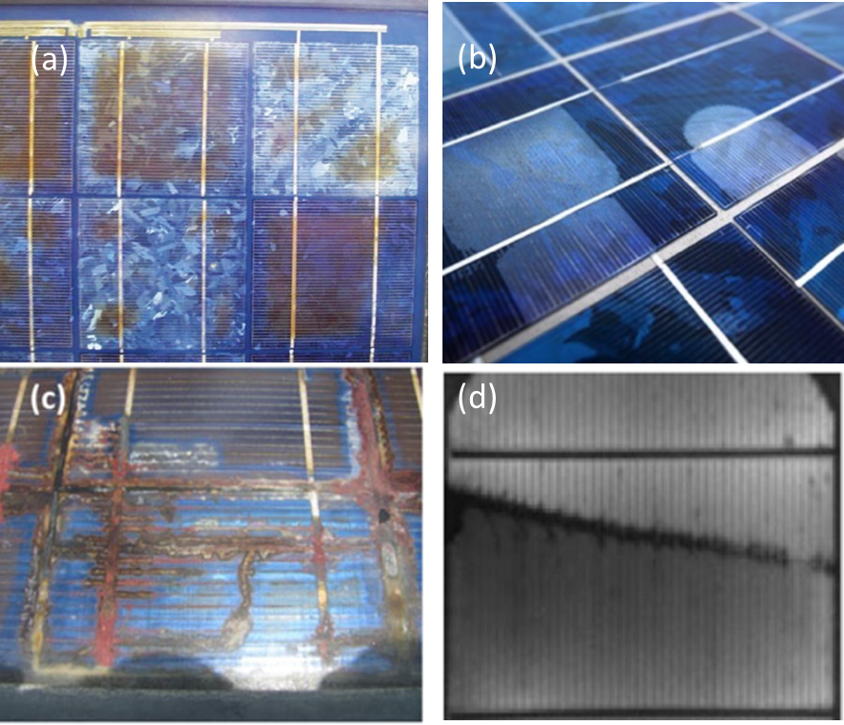
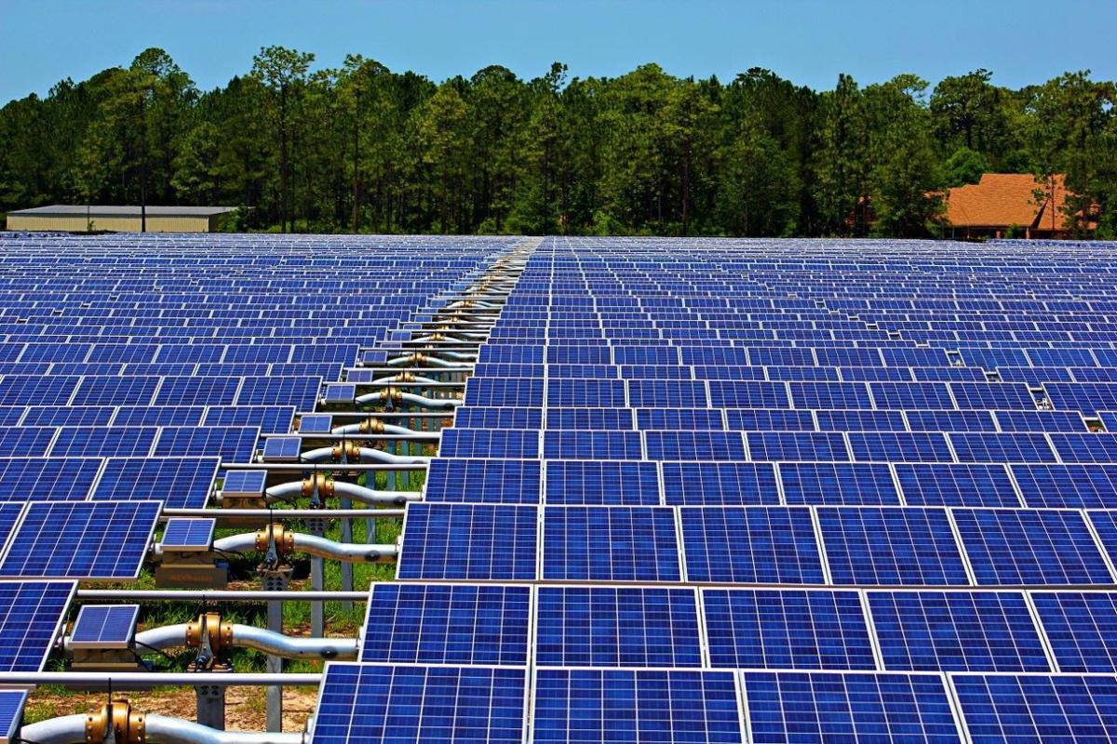
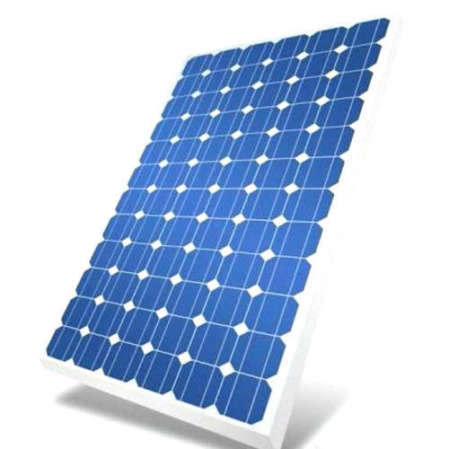
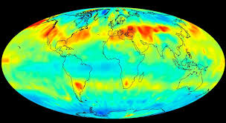
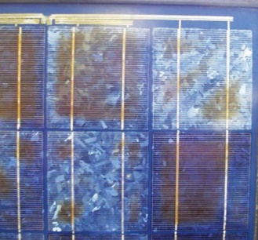
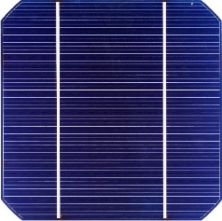
Introduction
Degradation Mechanisms
Module
*Google
*Google
Weather data
Input
Process
Output
Raw Field Data
Code
(Suns-Vmp)
Pre-process
Field Data
Files
+
+
Initial Parameters
Module datasheet
Analyzing the performance of degraded solar modules
Notes:
Renewable energy (LCOE metric)
Solar energy
reliability/degradation

Slide 3
Outline
Solar PV Research
  Introduction
  Input
  Tools
  Output
  Results
  Workflow
DEEDS dashboard
  Incorporation in the dashboard
  Datasets, cases, data, tools
Conclusion

Slide 4
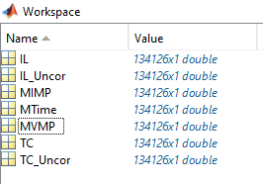

Input
Field Data (Field_Data.mat)
Initial Parameters (Ini_Para.mat)
function [] = main_run(jobname,NS,NP,NumofDay,DaiVar)
Jobname specification might be required as an input argument
$$R_{S}$$
$$J_{PH}$$
$$J_{01}$$
$$J_{02}$$
$$R_{SH}$$
Notes:
Other parameters NP(no. panels in parallel), NS (no. of cells in a panel) etc.
Jobname - Site name (case name)

Slide 5
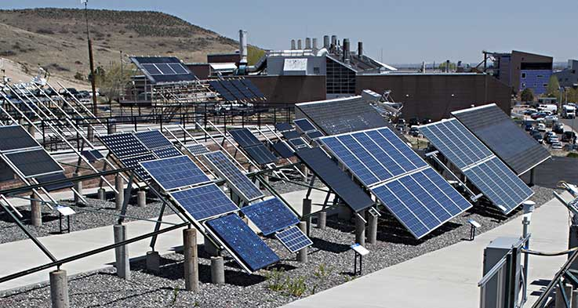
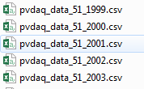
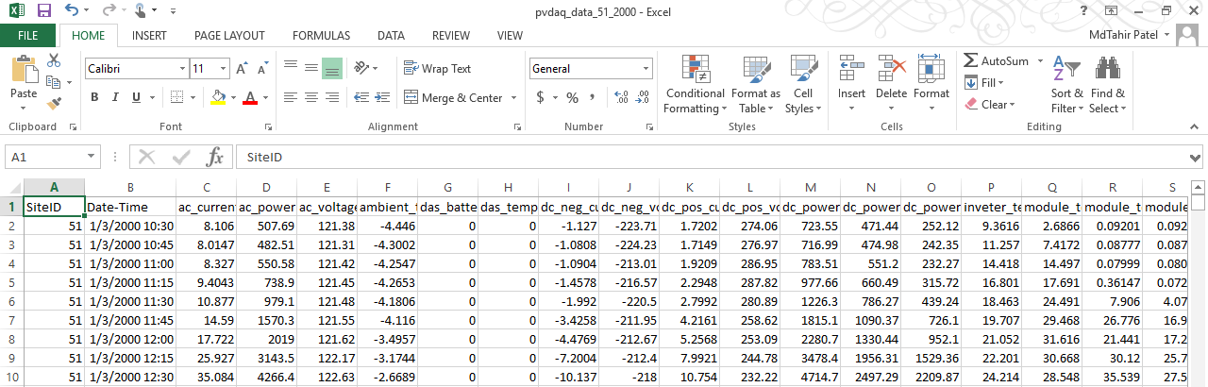
Inputs for Pre-processing
Raw field data (.csv files)
  Labeled (name) according to dataset_case_year.csv
  Contains site (case) name, date and time stamp, parameter values
  User should check for inconsistencies in data (NAN values in .csv)
Source: - System #51, NREL, Golden, Colorado

Slide 6
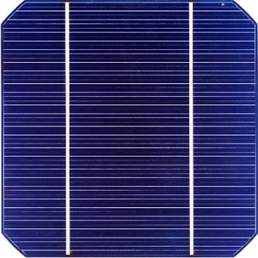
Inputs for Pre-processing
Data Correction
  Sandia M55 parameters (reflection loss, temperature,
  spectral mismatch etc.)
  Sandia PVLib (functions applied on M55 as .m files)
  Weather data (.csv, Source: NSRDB)
“Information.txt” file for site and module (lat, long, tilt, material, brand etc.)
Datasheet (for initial parameters for Suns-Vmp)
  Extracted I-V stored in M55_IV_Data using fit_data.m
$$R_{S}$$
$$J_{PH}$$
$$J_{01}$$
$$J_{02}$$
$$R_{SH}$$

Slide 7
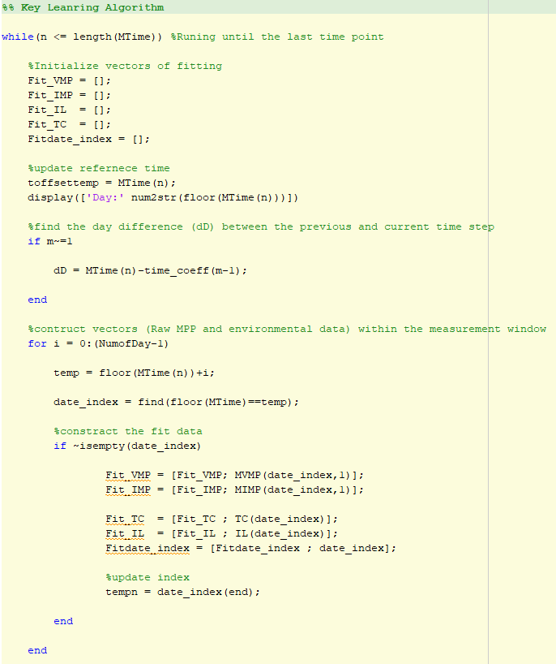
Tools
MATLAB
  Suns-Vmp analysis code (main script)
    Uses initial parameters and field data and fits Suns-Vmp model to find 5 parameters at each time step
    Efficiency degradation
    Deconvolves degradation effect of each parameter
  Output files (.mat, .csv)
$$R_{S}$$
$$J_{PH}$$
$$J_{01}$$
$$J_{02}$$
$$R_{SH}$$

Slide 8
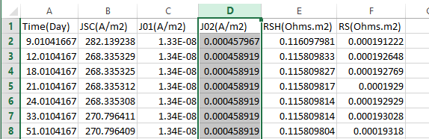
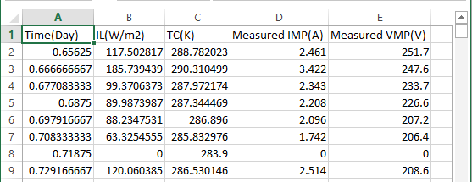
Output
Results for each site (case)
  .csv and .mat files
Analysis_Data.csv
Field_Data.csv

Slide 9
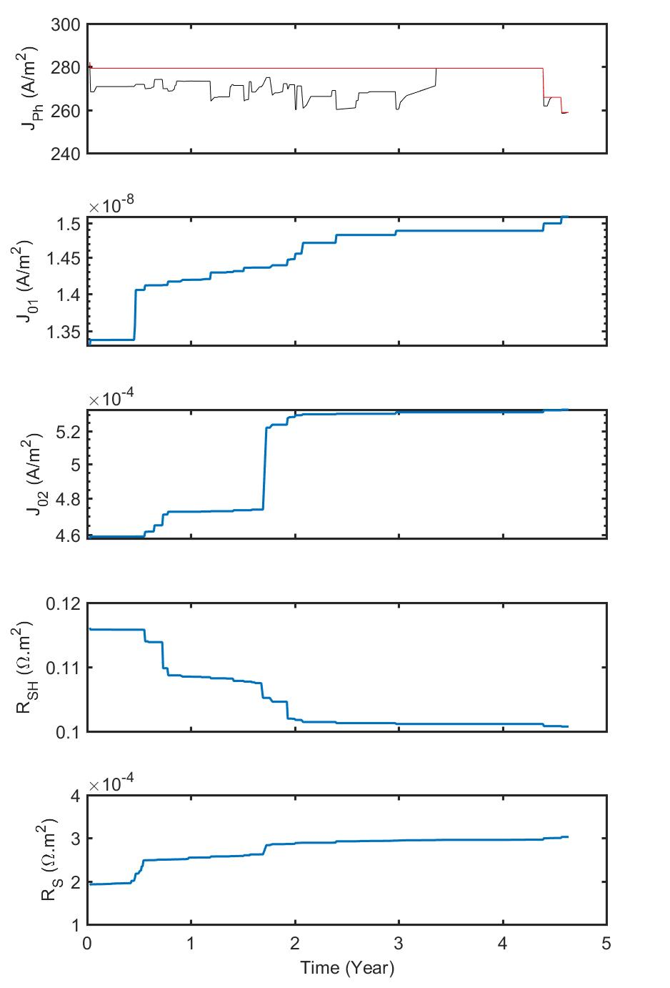
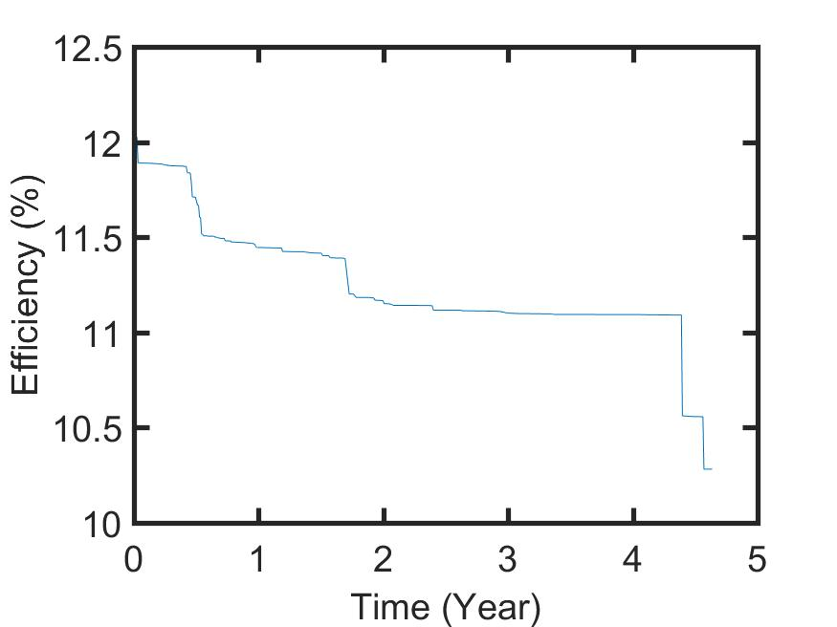
Results/Post-processing
Plots
  Matlab codes
$$R_{S}$$
$$J_{PH}$$
$$J_{01}$$
$$J_{02}$$
$$R_{SH}$$
*Not part of the results
Notes:
Provide the code for analyses/visualization as an expectation for DEEDS

Slide 10

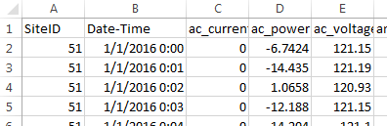

Workflow
Data Preprocessing (local computer)
Performance analysis (cluster/server)
*Input specific depending on CSV format (attributes, etc.)
*can be stored in CSV as well
Output stored in Mat files (MATLAB)
Raw Field Data
(CSV Files)
Preprocess (MATLAB codes)
*May run for days
Optimization Codes (MATLAB)
Mat Data Files (MATLAB)
Output Figure Files (MATLAB)

Slide 11
Outline
Solar PV Research
  Introduction
  Input
  Tools
  Output
  Results
  Workflow
DEEDS dashboard
  Incorporation in the dashboard
  Datasets, Cases, Files, Tools, Workflow
Conclusion

Slide 12
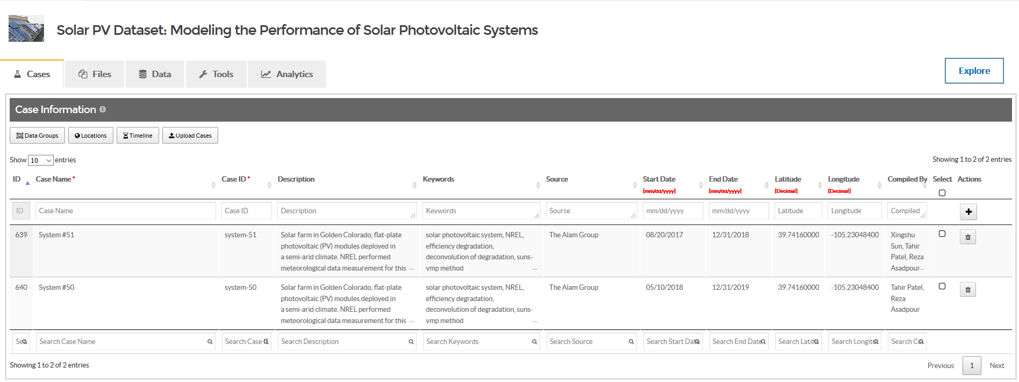
Solar PV Dataset: Modeling the Performance of Solar Photovoltaic Systems

Slide 13
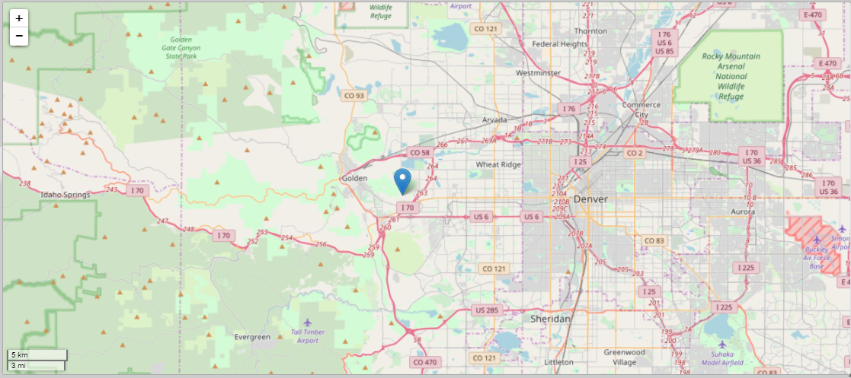
Cases
System #51 Golden Colorado
A PV “case” is a solar farm defined by module technology and field data for a site
Cases provide data that the performance modeling program can use to study long-term performance, reliability, and failures of PV modules
Different cases can have the same/different source (e.g., NREL – system #50,51)

Slide 14
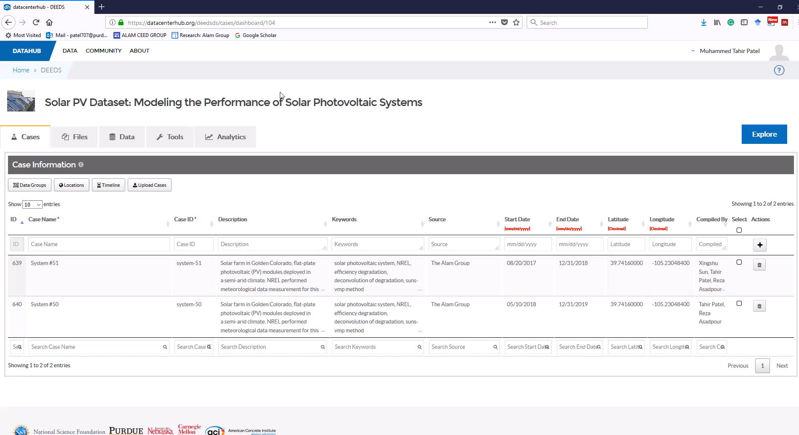
Working with DEEDS Database
Hover over the bottom of the slide to see the arrow for the video. Click on the video start arrow to begin the demonstration showing a researcher working with the DEEDS Solar PV dataset.

Slide 15
Pre/Post- processing
Pre
  Filtering and structuring of raw data files to yield input files for main code
  Site/Case-specific
  Example case – System #50 with tutorial video and manual
Post
  Codes, plots, files can be added
  Additional data analyses features on the dashboard

Slide 16
Outline
Solar PV Research
  Introduction
  Input
  Tools
  Output
  Results
  Workflow
DEEDS dashboard
  Incorporation in the dashboard
  Datasets, cases, files, tools, workflow
Conclusion

Slide 17
Solar PV-DEEDS Database
Weather data
Input
Process
Output
Raw Field Data
Code
(Suns-Vmp)
Files
Pre-process
Field Data
Post process
+
Initial Parameters
Module datasheet
Executable on Local Machine
Executable on DEEDS Database
Cases
Create
Organize
Files
Upload
Annotate
Preserve
Share
Educate
Tools
Define
Launch
Workflow
Versions
Analysis
Post-process
Data analysis
Compare cases
A Complete Package
Notes:
--create cases that define your research activities
--define/preserve/annotate/share your data & files
--define/launch/trace your tools & computations

Slide 18


