Slide 1
DEEDS
A Platform for Sharing Data, Computing & Scientific Workflows
CIF21 DIBBs: EI: Digital Environment for Enabling Data-driven Science (DEEDS) PI: Ann Christine Catlin | co-PIs: Ashraful Alam, Joseph Francisco, Marisol Sepulveda, Connie Weaver
Award #1724728 | Award Period August 2017 – July 2021
DEEDS “Use Cases” Workshop
June 29 2018

Slide 2
Data
Infrastructure
Code
Files
Platform
Input
Output
Dashboard
Upload
Spreadsheets
Annotate
Computing
Workflows
HPC
Servers
Models
Analytics
Interfaces
Outcomes
Sharing
Figures
Access
Results
Reports
Applications
Publication
Exploration
Reuse
Dissemination
Discovery

Slide 3
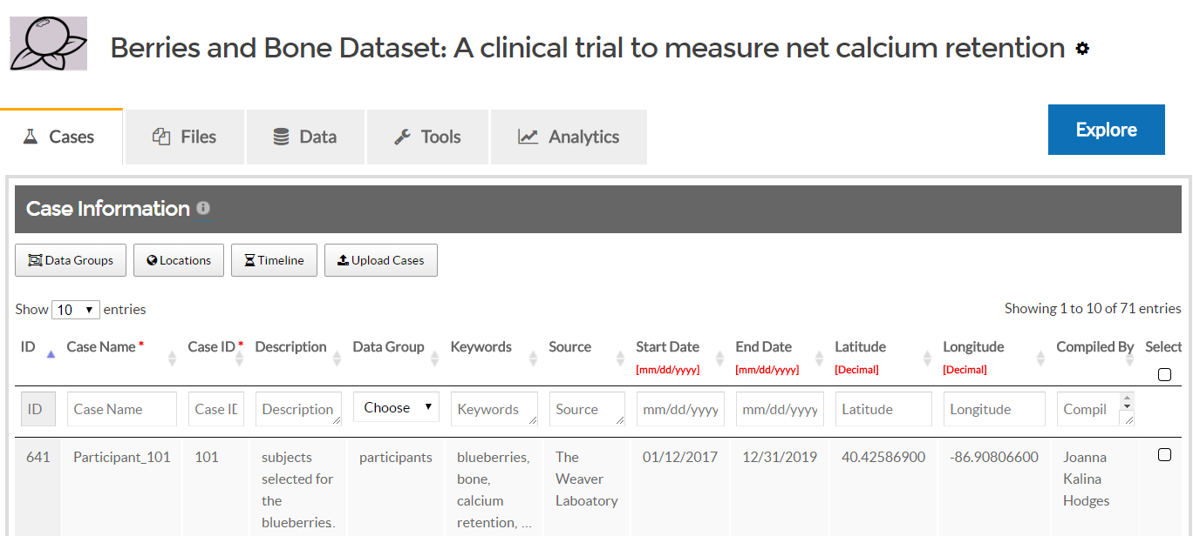
DEEDS DASHBOARD
Interactive interfaces join heterogenous dataset content so users can view, search, sort, filter, explore, download, compare, visualize, map the data in their dataset.
Users define and launch computing software, assign resources (e.g., HPC), select input, and trace execution.
Output is automatically collected, annotated, classified, and uploaded to the dataset.
Research workflows are captured end-to-end.
Users define complex structured data models to describe properties, measurements, observations, and other data assembled throughout the investigation.
Our “spreadsheets of spreadsheets” approach is used to upload, view, and operate interactively on multi-dimensional data tables.
Users upload, annotate & classify files such as reports, figures, photos, device data, input, output, and any other files produced throughout the investigation.
Interactive interfaces let users explore file collections, which are organized into mime-based categories for ease of use and discovery.
Users organize datasets by “cases” (experiments, subjects, specimens, sites, study units, research activities) to clarify how their investigation is conducted.
This interpretive framework makes experimental design and dataset content easier for researchers to understand and use since Files & Data are connected to the activities that produced them.

Slide 4
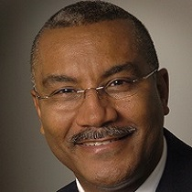
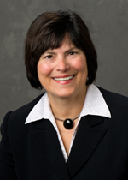
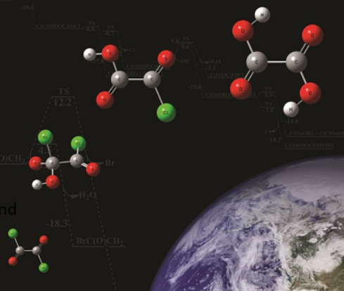
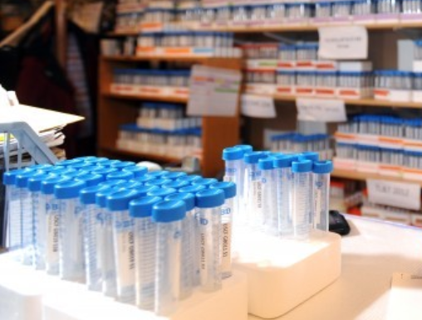
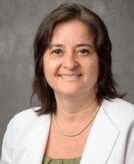
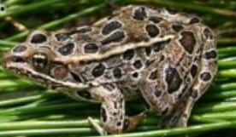
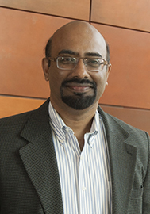
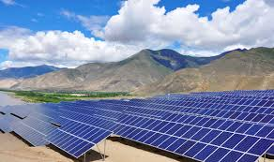
Chemistry
Nutrition Science
Optimization of molecular structure and determination of properties
Effect of berries on net calcium retention & biochemical markers of polyphenol and bone metabolism
Joe Francisco
University of Pennsylvania
Connie Weaver
Purdue University
Post-doctoral Researcher Ross Hoehn
Post-doctoral Researcher Kalina Hodges
Environmental Science
Electrical Engineering
Performance modeling of solar PV systems
Development of amphibian toxicity reference values for ecological risk assessment
Marisol Sepúlveda
Purdue University
PhD Students
Tahir Patel
Reza Asadpour
Xingshu Sun
Post-doctoral Researcher Wes Flynn
Research Laboratory Manager Sam Guffey
Ashraf Alam
Purdue University

Slide 5
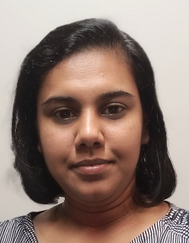
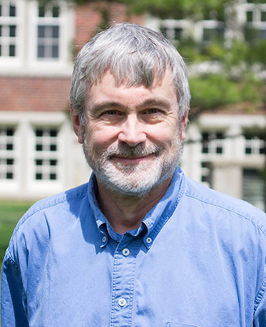
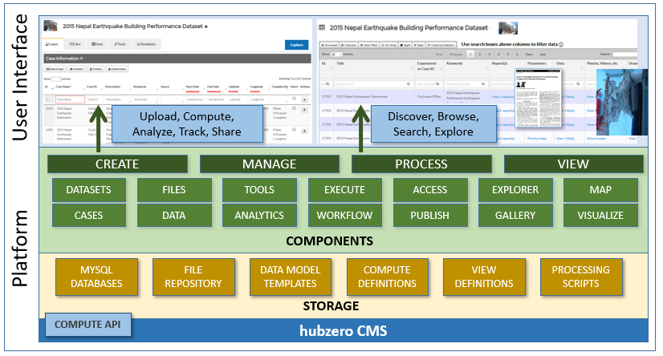
Research Computing
R&D Lead for DEEDS Project
Research Computing
Computing Infrastructure
Chandima Hewa Nadungodage
Purdue University
Steve Clark
Purdue University
Senior Software Engineers
Sumudinie Fernando
Guneshi Wickramaarachchi
Computer Science PhD Student
Andres Bejarano
Computer Science Masters Students
Paramesh Desigavinayagam
Omkar Patil
with support from the hubzero team
Pascal Meunier
Anthony Fuentes
DEEDS platform architecture: sharing data, computing & scientific workflows

Slide 6
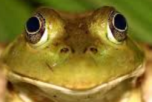
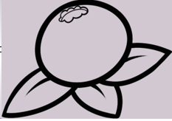
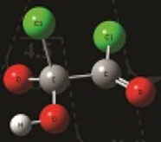
DEEDS TIMELINE
Solar PV
EcoTox
Berries, Quantum
All
Research cases, input/ output files, computing code, HPC execution & workflow
Research cases, data model for collected measurements, spreadsheets, workflow
Research cases, input/output files, research computing, complex data models & collected measures, data & computing workflows
Create datasets, evaluate DEEDS platform completeness & usability, testing, feedback
SEP 2017
NOV-DEC 2017
MAR-JUN 2018
DEEDS TEAMS
AUG 2017
OCT 2017
JAN-FEB 2018
JUN 2018
DEEDS R&D
DEEDS R&D
DEEDS R&D
Platform requirements, dashboard design, user interfaces design for cases & files, tools infrastructure, “submit” requirements , web component structure
Requirements analysis, dashboard feature prototyping, user interface design for data models, user interface prototyping, database & repository structure
Ongoing design & development, prototype platform, dashboard functionality for cases, files, data, & tools, dataset building& testing. Extensions, enhancements, fixes.
DEEDS implementation begins
DEEDS
version 1

Slide 7
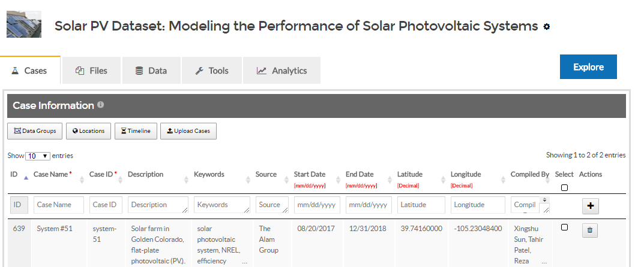
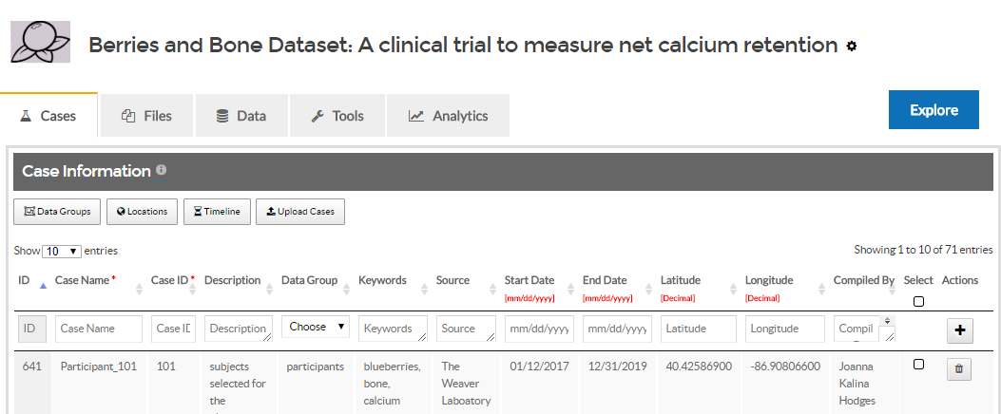
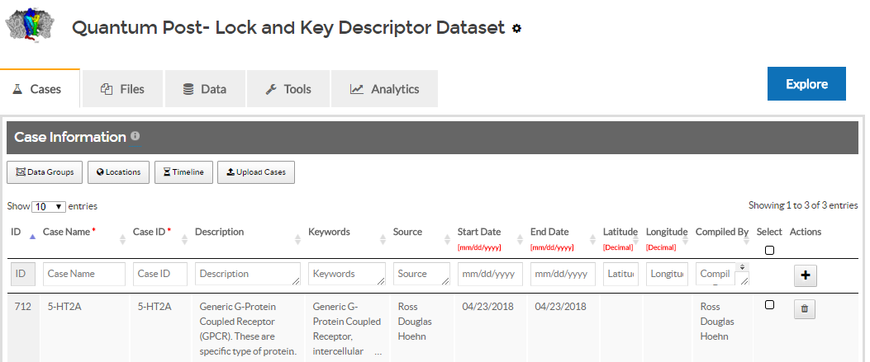
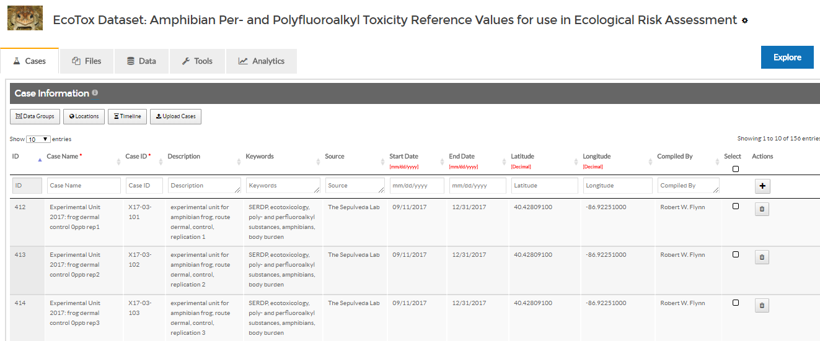
DEEDS SCIENTIFIC DATASETS
Create
Organize
Preserve
Compute
Share
Explore
Learn
Educate
Publish
Reuse

