Slide 1
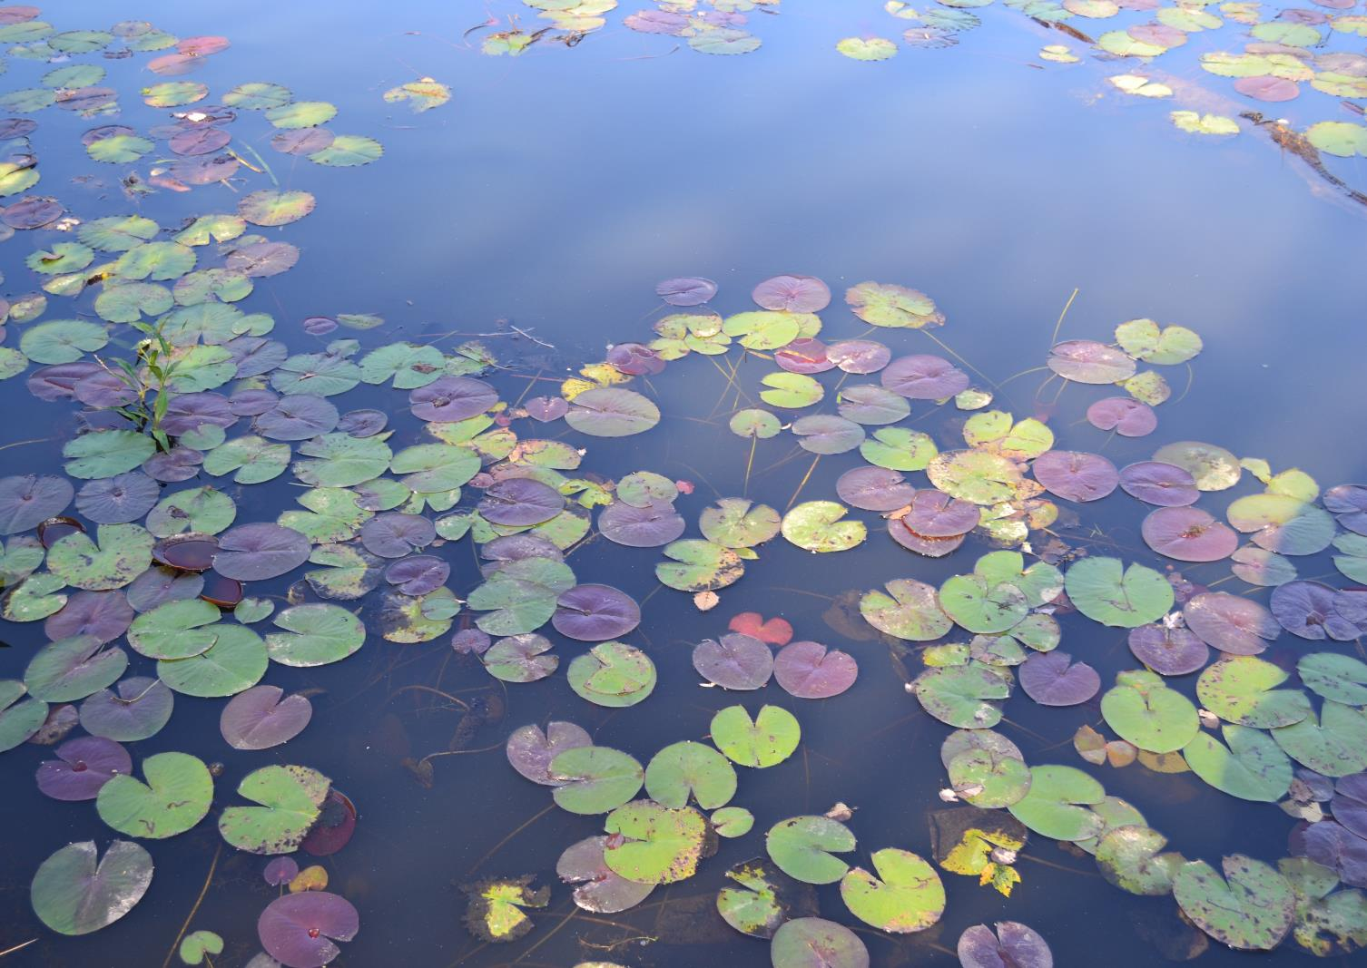
Amphibian PFAS Toxicity Reference Values for Ecological Risk Assessment
Wes Flynn
PIs: Marisol Sepulveda, Jason Hoverman, Linda Lee
Graduate Students: Gary Hoover, Sarah Abercrombie

Slide 2
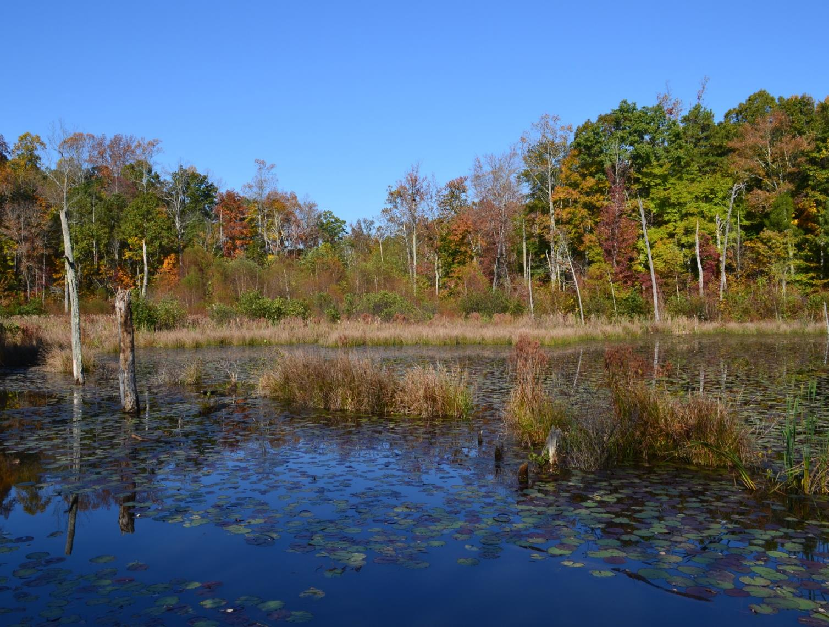
Overarching Question
What is the ecological risk posed by PFASs to amphibians?

Slide 3
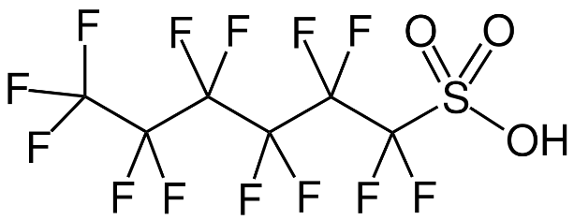
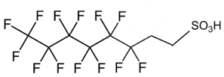
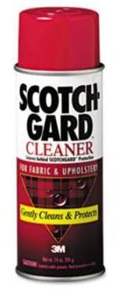
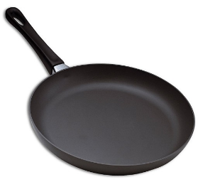
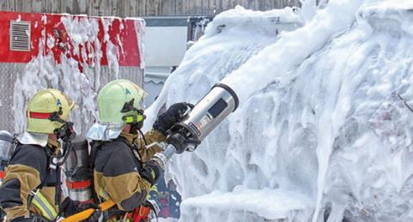
Project Overview
Per- and Polyfluorinated Substances (PFASs)
Organic compounds used in variety of applications
Resistant to degradation
Bioaccumulation
Disruption of endocrine function
PFOA
PFOS
PFHxS
6:2 FTSA
Notes:
Possess properties desirable for a lot of applications: chemical and thermal stability = don’t easily breakdown so products last longer; and both hydrophobic and lipophobic = effectively repel water and oils

Slide 4
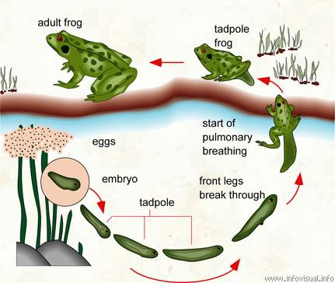
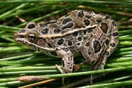
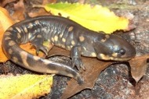
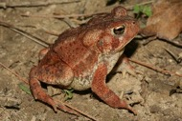
Project Overview
Amphibians
Declines tied to human impacts on the environment
Complex life histories
Endocrine system critical in this process
Species have different diets and developmental times

Slide 5
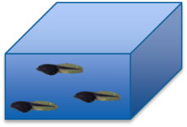
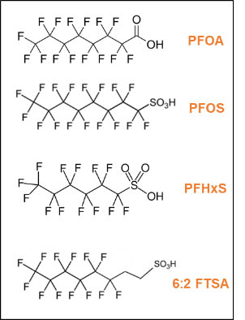
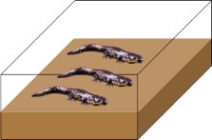
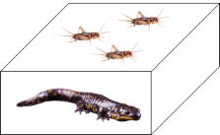
Project Overview
Uncertainty of risk posed by PFASs
Compounds are of greatest concern?
Taxa at greatest risk?
Exposure routes most likely to pose greatest risk?
Aquatic
Dermal
Diet

Slide 6
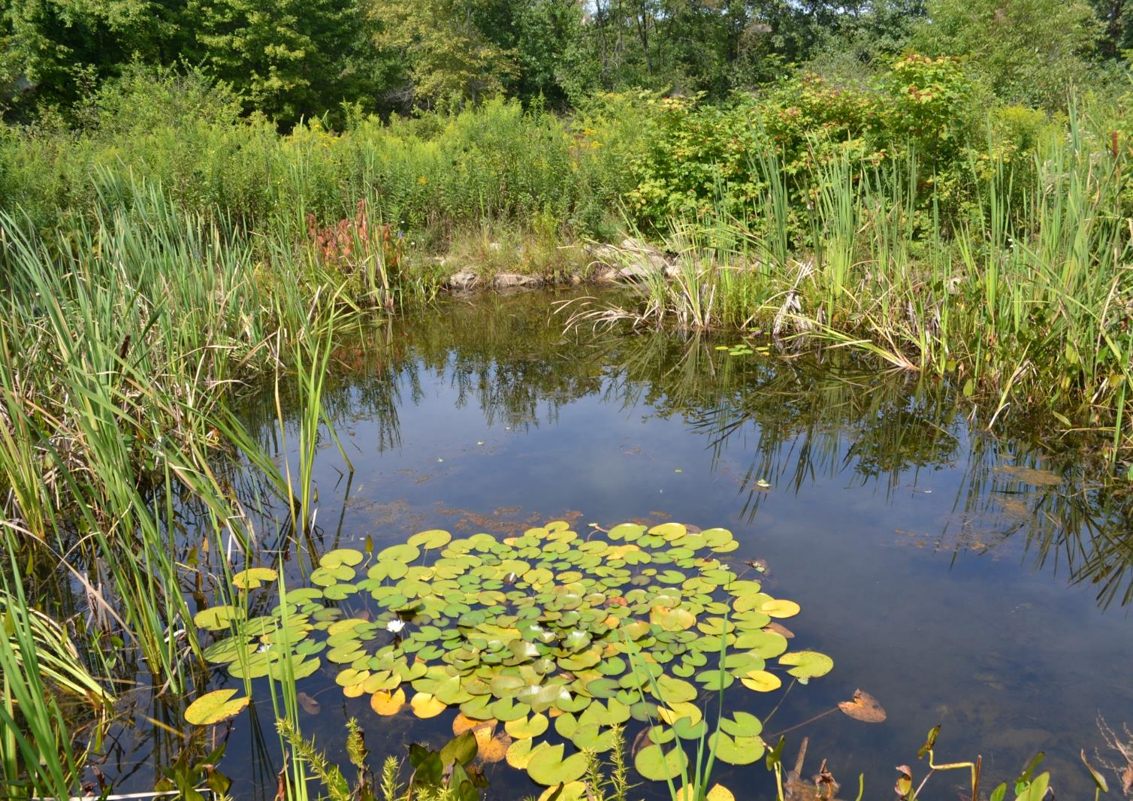
Primary Objective
Determine toxicity reference values specific to species, compounds, and routes of exposure
Under what conditions would we predict negative health outcomes?
These data and results are critical to the creation of effective policy and management

Slide 7
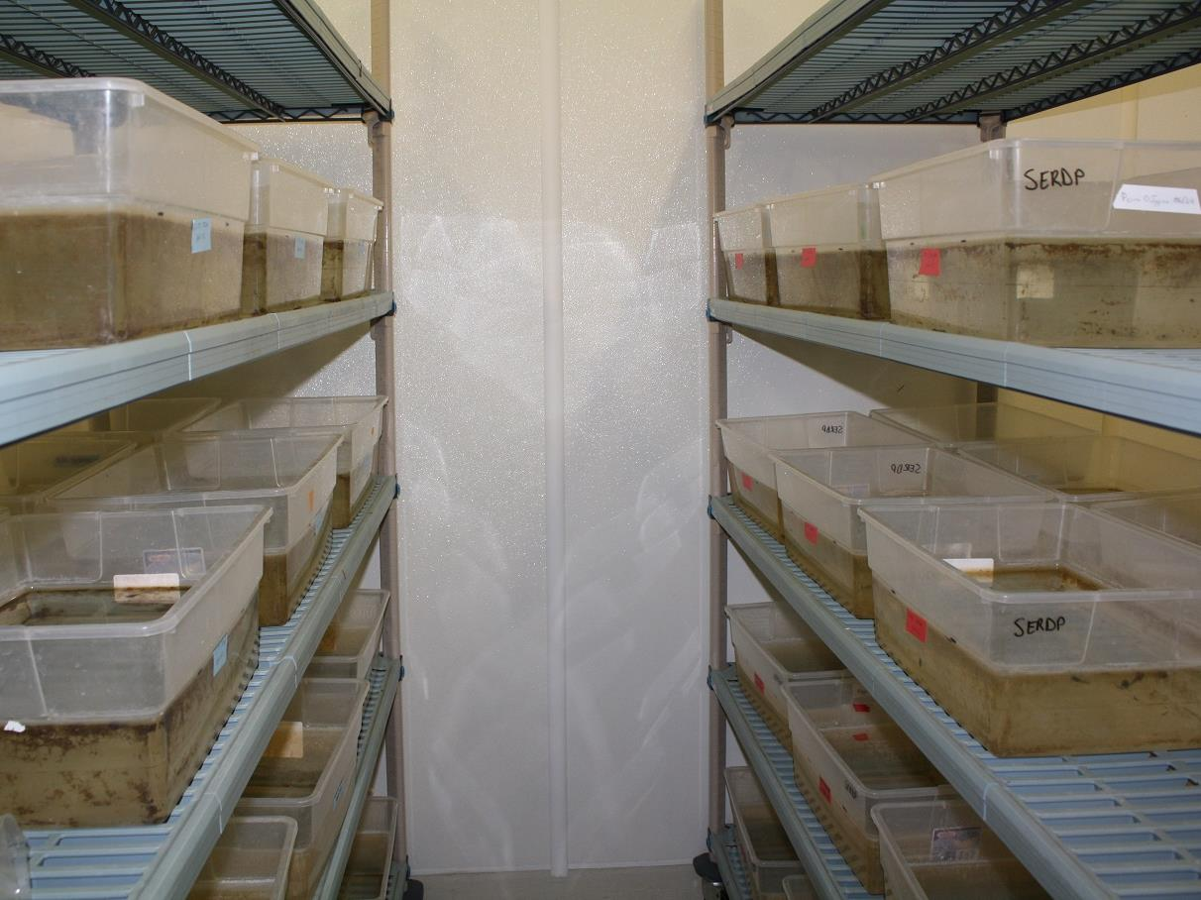
Experimental Approach
Three species
Four chemicals
Three concentrations/chemical
Measurements taken over course of experiments (i.e. repeated measure)
Control (0 µg/L)
10 µg/L
100 µg/L
1000 µg/L

Slide 8
Experimental Approach

Slide 9
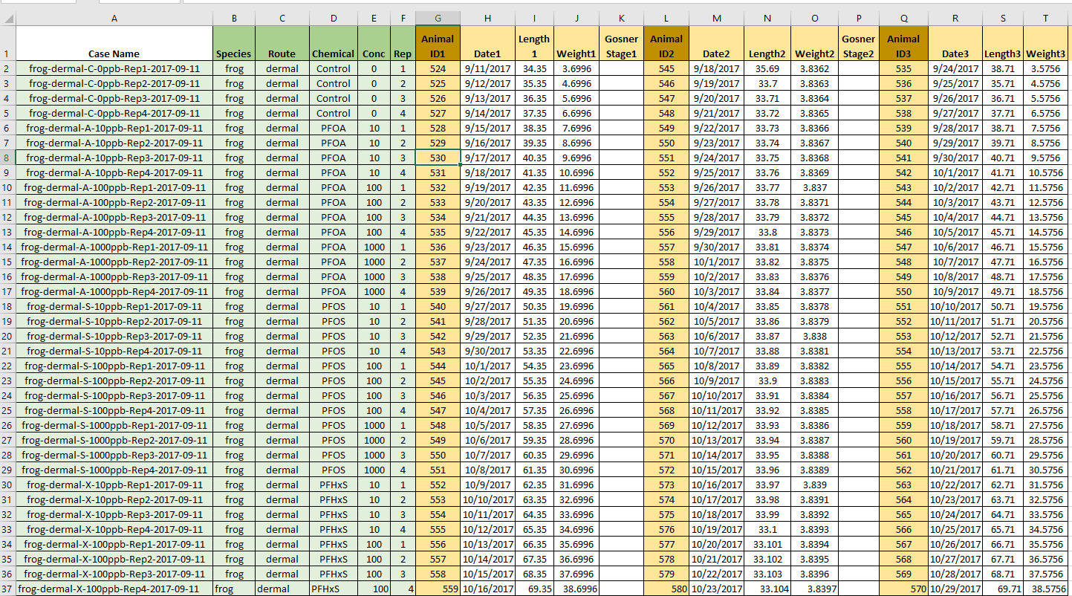
Data Structure

Slide 10
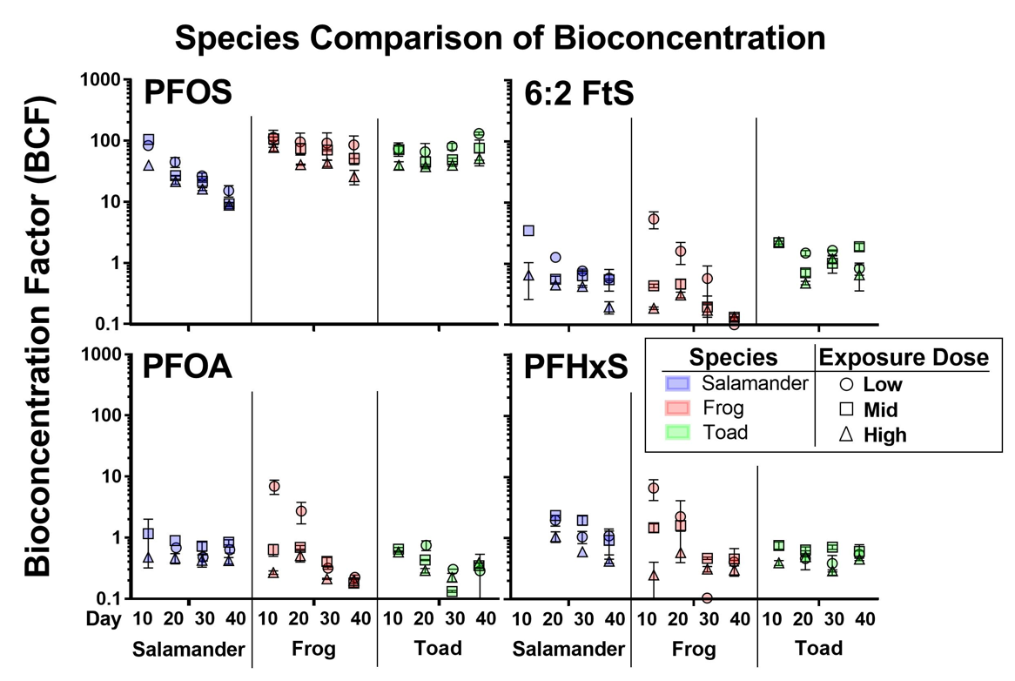
Data Visualization

Slide 11
Data Visualization
Tool Information
Short name
pfos-plotting
Plots for PFOS concentration in aquarium media across species and treatments
Name
Plots for mass spectrometry chemical concentration measures (ug/g) in aquarium media (water, moss, sediment) across species and treatments
Description
Developed by
Robert W. Flynn
Date Developed
06/02/2018
Save
Next >

Slide 12
Data Visualization

Slide 13
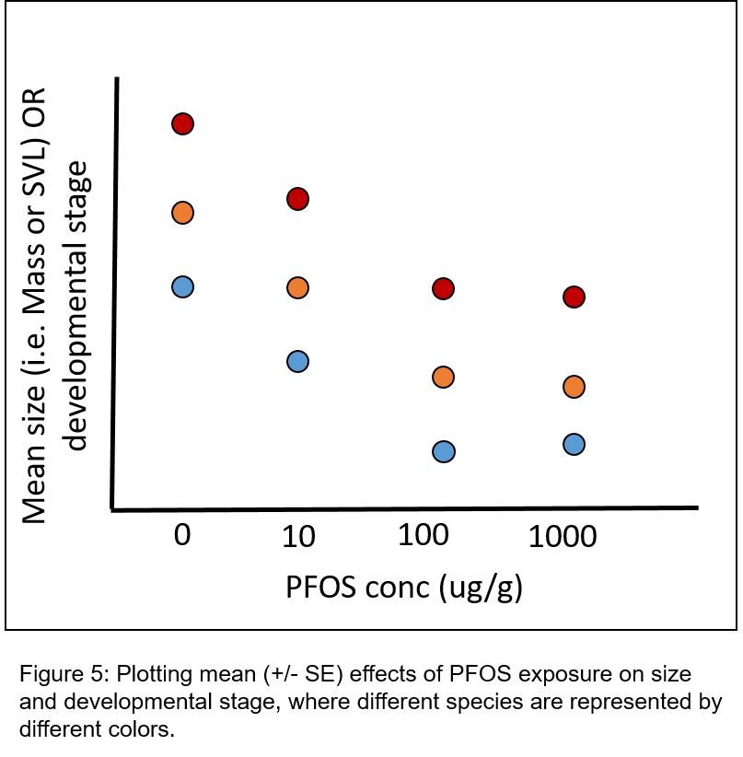
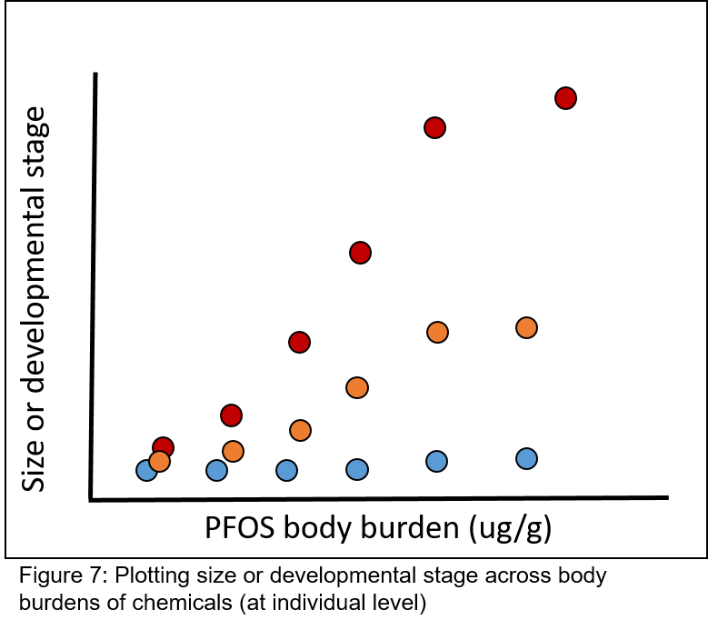
Data Visualization

Slide 14
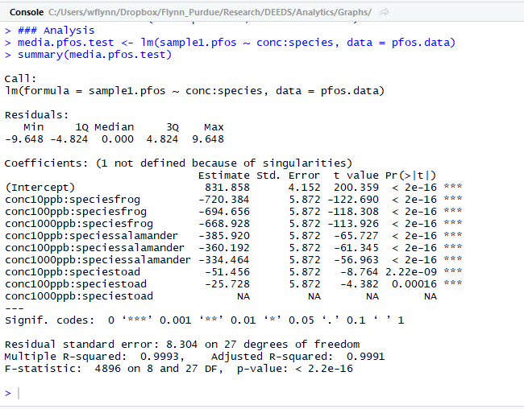
Data Analysis

Slide 15
What DEEDS does for us
Data preservation and sharing
Workflow tracking
Repeatability!
Visualizing data from across multiple related studies

Slide 16
Challenges associated with data structure
Experimental units (aquaria) housing multiple animals
Observations occur at both experimental unit (case) and sub-experimental unit (individual animals within units)
These aspects result in challenges to standardizing data format in a way that is ideal for DEEDS data management and analysis/plotting

Slide 17
Acknowledgements
DEEDS Team
SERDP Team
PIs
Marisol Sepulveda, Jason Hoverman, Linda Lee
Technical Staff
Sam Guffey, Mike Iacchetta,
Chloe DePerre
Graduate Students
Gary Hoover and Sarah Abercrombie
Quality Assurance
Laurel Branstator
Funding

