Slide 1


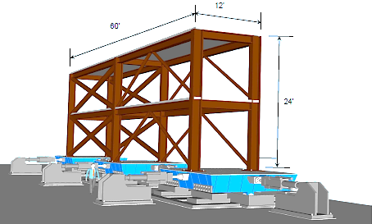
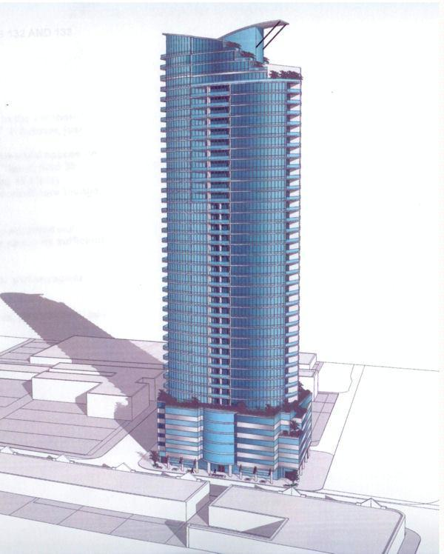
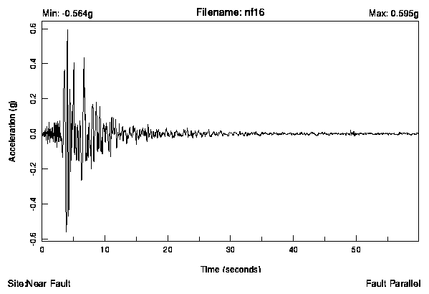
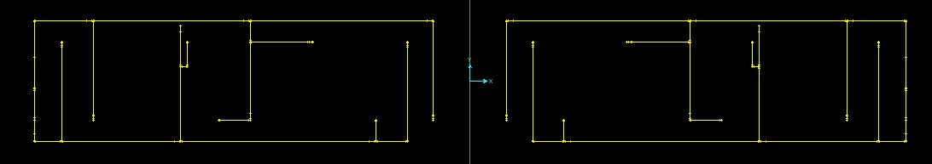
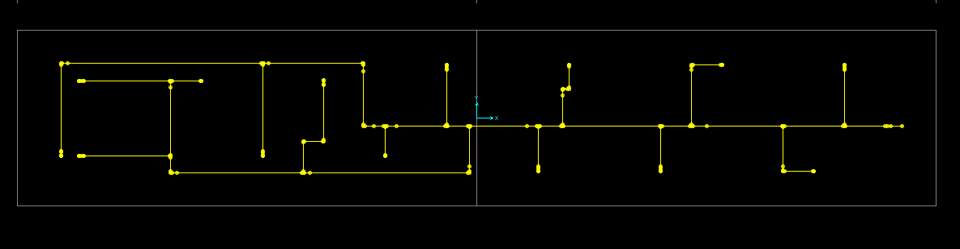
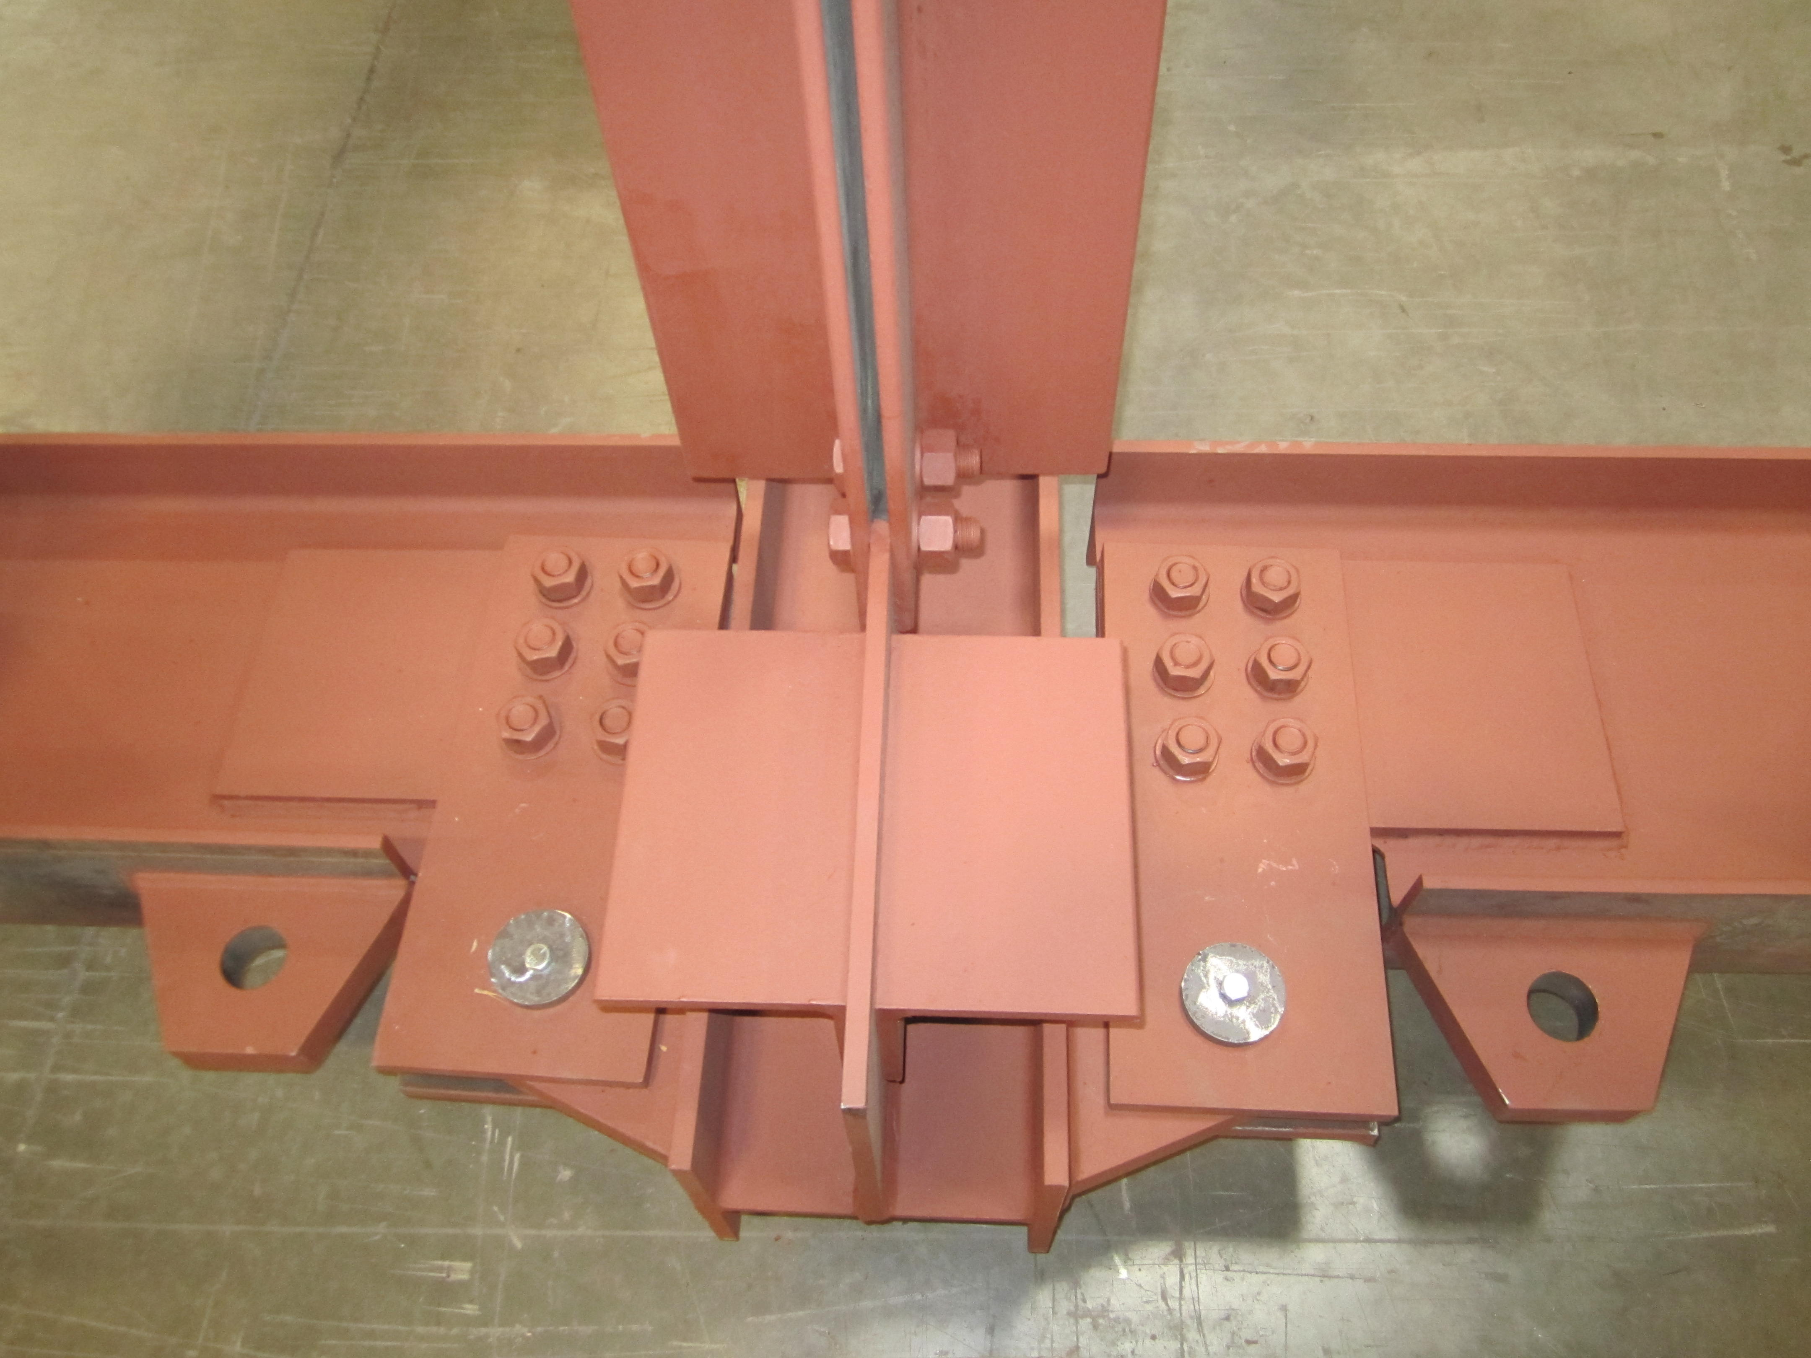
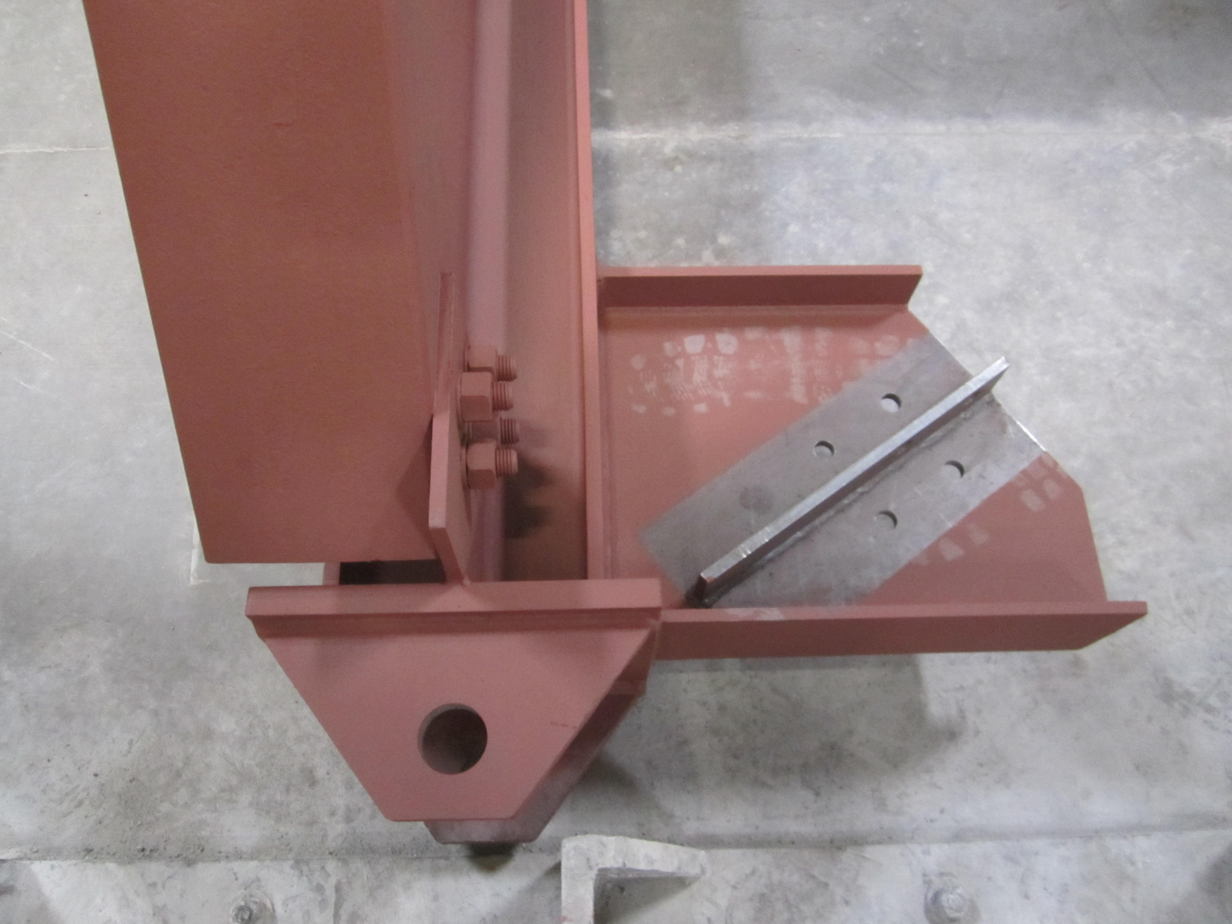
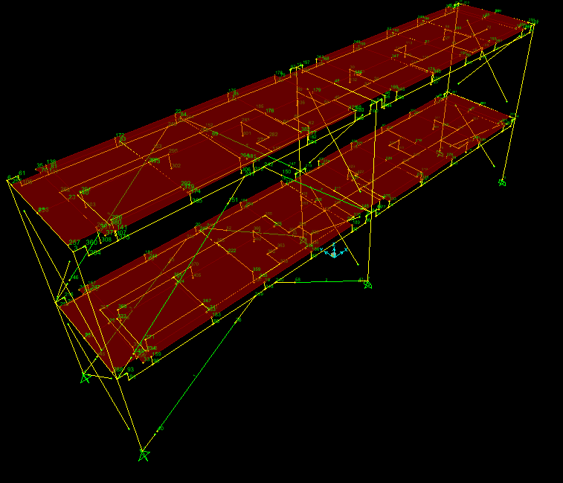





Simulation for Seismic Performance of Nonstructural Systems (Nonstructural Grand Challenge)
Emma Crossman-University of Nevada, Reno
emmacrossman@me.com
Test Bed
PIs: Manos Maragakis, Ahmad Itani, and Gokhan Pekcan
Mentor: Siyavash Soroushian
Host Institution: University of Nevada, Reno
Introduction
A Test-Bed structure (a two-story, 2-bay by 1-bay steel framing system) was designed and constructed to simulate the realistic dynamic environment for the ceiling/sprinkler piping systems. This structure will be mounted longitudinally over three bi-axial shake tables (Figure 3).
The test-Bed structure simulates the floor response of any upper story of a multistory building (Figure 4). The shake table input motion was developed so that the acceleration or drift response of the test-bed frame replicates higher levels a building.
Testing Outcomes
In recent earthquakes nonstructural damage renders critical facilities such as hospitals and airports inoperable. The durability of nonstructural components, including piping systems, during an earthquake is essential to the functionality of the facility after an earthquake. Due to a lack of knowledge and research there are no specific standards required for the design of piping systems in seismically active areas. To obtain more information, a series of system-level full-scale experiments of ceilings-piping-partition systems will be conducted at the University of Nevada, Reno NEES Site, in October 2012. The experiment includes the design, analysis, construction, and testing of the system.
A reusable test-bed structure was designed for shake table investigations of nonstructural systems. In October 2012 the test bed will be placed on the shake tables and the two different piping systems will be tested. The results will be compared to pre-experiment analysis and conclusions will be drawn based on the accuracy of the computer models.
Figure 3: Two story test bed spanning across three biaxial shake tables.
Future Use
Reveal how subsystems interact with structural and non structural systems.
Develop guidelines or specifications for designing piping systems in seismically active areas.
Pre-experimental analysis will predict the effects of the earthquake ground motions on the piping systems.
Pre-experiment Analysis
Pre-experimental analysis was performed using SAP2000, OpenSEES, and MatLab. First, two realistic hospital sprinkler piping layouts were modeled in SAP (Figure 1 and 2). Next the piping systems were transfer to OpenSEES. Once the OpenSEES models were verified with the SAP models, earthquake motions derived using MatLab were input to predict the effects of an earthquake on the piping system.
Literature Cited
Drive Motion
Ground-Controller
Transfer Function
Ground Motion
American Lifeline Alliance (ALA), (2002). Seismic Design and Retrofit of Piping System.
Computers and Structures, Inc. (CSI), (2009). CSI Analysis Reference Manual for SAP2000,
Berkeley, CA.
Figure 4: Ground motion applied to test bed simulates the ground motion felt by upper stories of a high-rise building.
A
Acknowledgements
B
Beam-Column Connection
Base Connection
This project was funded by the National Science Foundation under Grant No. 0721399. NSF Project: # CMMI-0721399
Figure 1: (A) SAP model of piping system 1
(B) SAP model of piping system 2
Further Information
Figure 4: Two different types of bracing for test bed structure.
For further information reguarding this project please contact Siyavash Soroushian @ siyavashs@yahoo.com
Two designs were considered for the Test-Bed structure by implementing two sets of bracing systems. Elastic braces restrained against buckling were used to achieve large floor accelerations, and buckling resistant braces (BRBs) were used to produce large inter-story drifts (Figure 4).
Figure 2: SAP model of the two story test bed with first piping system.

